Slide 1
Authenticating Handwritten Bengali Signatures with Deep Learning

Slide 2
TABLE OF CONTENTS
INTRODUCTION
LITERATURE REVIEW
METHODOLOGY
EXPERIMENTAL ANALYSIS
RESULT AND DISCUSSION
FUTURE WORK

Slide 3
WHAT?
Explores the effectiveness of an offline signature verification system
Focuses on Bengali Signature
Explore ML models for image classification.

Slide 4
WHY?
To improve signature authentication in the field of information security.
To reduce instances of fraud and other criminal activities.
To implement ML to automate image classification.

Slide 5
HOW?
Pre - Processing : Histogram-based threshold technique, Resize(256,256)
Transfer Learning Approach : MobileNetV2, Xception, VGG-19
Model Build-up : Base Model(Transfer Learning) + CNN

Slide 6
LITERATURE REVIEW
SERIAL | PAPER NAME | AUTHOR NAME | METHOD | ACCURACY
1. | Learning Features for Offline Handwritten Signature Verification using Deep Convolutional Neural Networks | Luiz G. Hafemann, Robert Sabourin, Luiz S. Oliveira | Convolutional Neural Networks to enhance signature verification, particularly against skilled forgeries. By incorporating knowledge of forgeries during feature learning. | GPDS-160: EER: 1.72%

Slide 7
LITERATURE REVIEW
SERIAL | PAPER NAME | AUTHOR NAME | METHOD | ACCURACY
2. | Signature Verification using Convolutional Neural Network | Shayekh Mohiuddin Ahmed Navid, Shamia Haque Priya, Nabiul Hoque Khandakar, Zannatul Ferdous, Akm Baharul Haque | The model is based on VGG-19. Activation functions include ReLU, Sigmoid, and Softmax. The top classification layer was replaced with a fully connected layer outputting 2 classes. | ICDAR(100%), Kaggle(94.44%),CEDAR(88%)

Slide 8
LITERATURE REVIEW
SERIAL | PAPER NAME | AUTHOR NAME | METHOD | ACCURACY
3. | SigNet: Convolutional Siamese Network for Writer Independent Offline Signature Verification | Sounak Dey, Anjan Dutta, Igancio Toledo, Suman K.Ghosh, Josep Lidaos, Umapada Pal | Applied Normalization on pre-processing, then used CNN Architecture. | CEDAR - 100% GPDS300 - 76.83% GPDS Synthetic - 77.76% Bengali - 86.11% Hindi - 85.90%

Slide 9
LITERATURE REVIEW
SERIAL | PAPER NAME | AUTHOR NAME | METHOD | ACCURACY
4. | An Efficient Signature Verification Method based on an Interval Symbolic Representation and a Fuzzy Similarity Measure | Alaei, Ali Reza, Pal, Srikanta, Pal, Umapada, Blumenstein, Michael | The proposed method includes four main steps: a) preprocessing, b) feature extraction, c) creation of an interval-valued symbolic model for each individual, and d) computation of similarity values and the final decision | 86.15

Slide 10
LITERATURE REVIEW
SERIAL | PAPER NAME | AUTHOR NAME | METHOD | ACCURACY
5. | Performance of an Off-Line Signature Verification Method Based on Texture Features on a Large Indic-Script Signature Dataset | Srikanta Pal, Alireza Alaei, Umapada Pal, and Michael Bluumenstein | Composed of preprocessing, feature extraction, and verification steps. A Nearest Neighbour (ANN) classifier with a Euclidean distance is used for verification | Bangla - 66.18% Hindi - 75.53% BHSig260 - 87.28%

Slide 11
LITERATURE REVIEW
SERIAL | PAPER NAME | AUTHOR NAME | METHOD | ACCURACY
6. | Offline Bangla Signature Verification: An Empirical Study | Srikanta Pal , Alireza Alaei , Umapada Pal , Michael Blumenstein | For feature extraction undersampled bitmap, intersection/endpoint and directional chain code have been used and for classification, Nearest Neighbour Method have been used. | AER of 15.57%

Slide 12
DATASET
We are working with the BHSig260 BENGALI dataset and our own dataset in
total of 5280 signature images, of which 2640 signatures are genuine and 2640 signatures are forged.

Slide 13
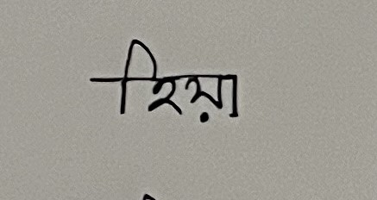
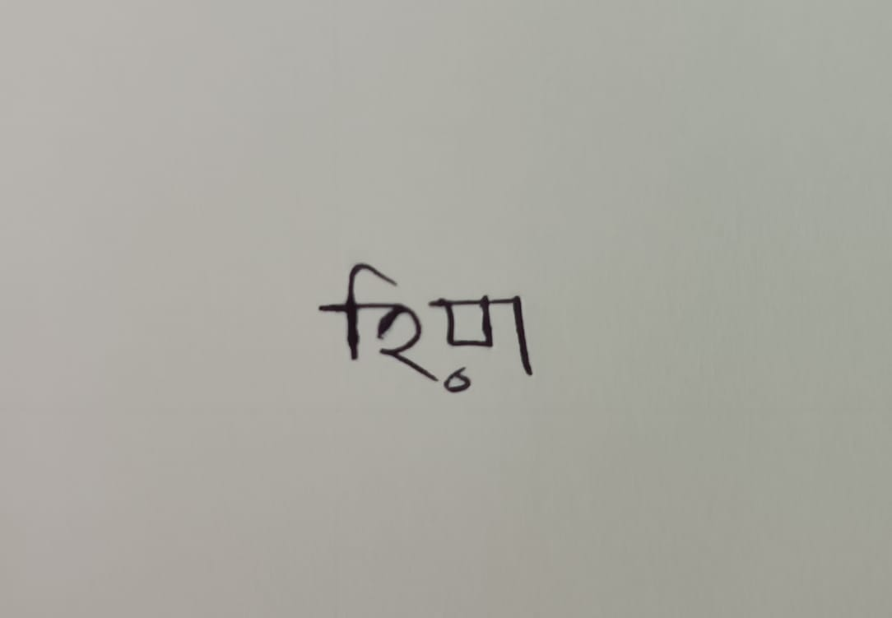
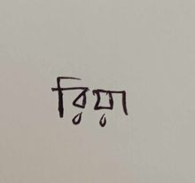
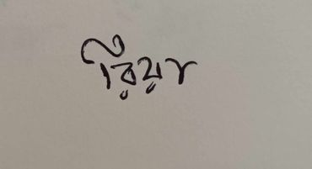
DATASET SAMPLE

Slide 14
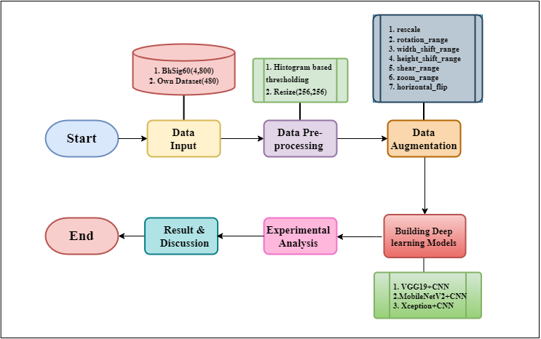
METHODOLOGY

Slide 15
EXPERIMENTAL RESULTS
Models | Accuracy | Precision | Recall
VGG-19 | 89.32 | 100 | 4.5
MobileNetV2 | 90.10 | 50.81 | 99.09
Xception | 84.89 | 50.22 | 100

Slide 16
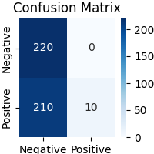
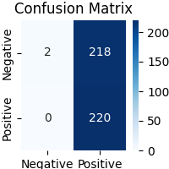
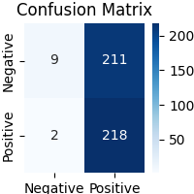
RESULT ANALYSIS
VGG-19
Xception
MobileNetV2

Slide 17
THANK YOU

